Slide 1






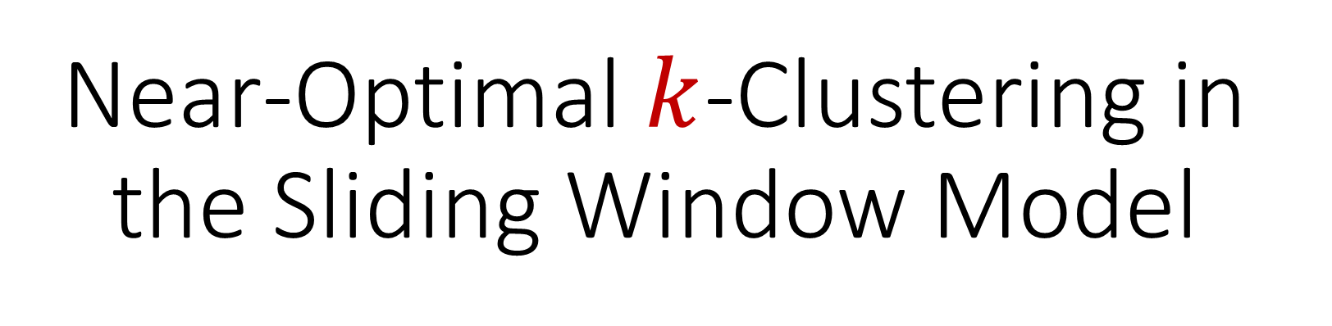
Near-Optimal $k$-Clustering in the Sliding Window Model
David P. Woodruff
Peilin Zhong
Samson Zhou

Slide 2
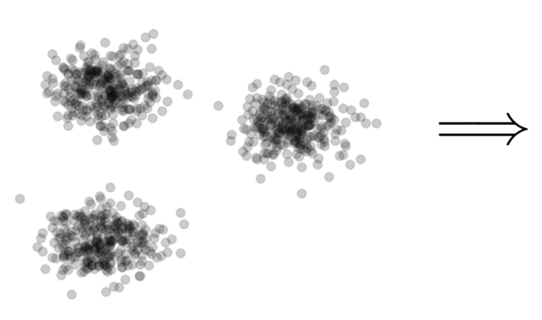

Clustering
Goal: Given input dataset $X$, partition $X$ so that “similar” points are in the same cluster and “different” points are in different clusters

Slide 3
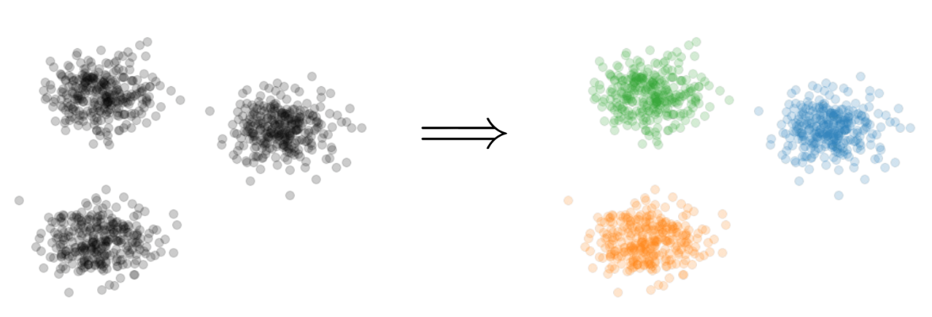
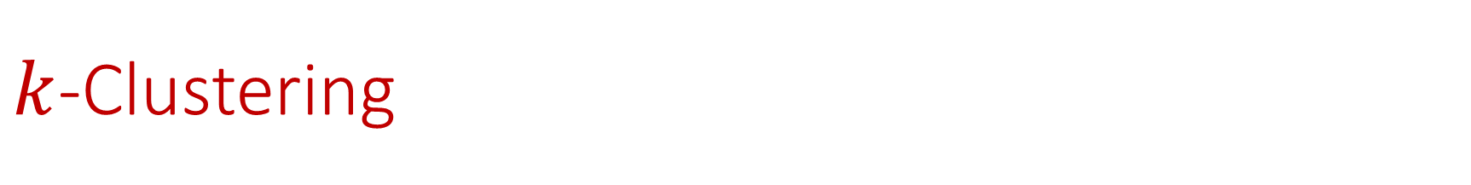

$k$-Clustering
Goal: Given input dataset $X$, partition $X$ so that “similar” points are in the same cluster and “different” points are in different clusters
There can be at most $k$ different clusters
$$k=3$$

Slide 4
$k$-Clustering
Question: How do we measure the “quality” of each clustering?
$$k=3$$

Slide 5
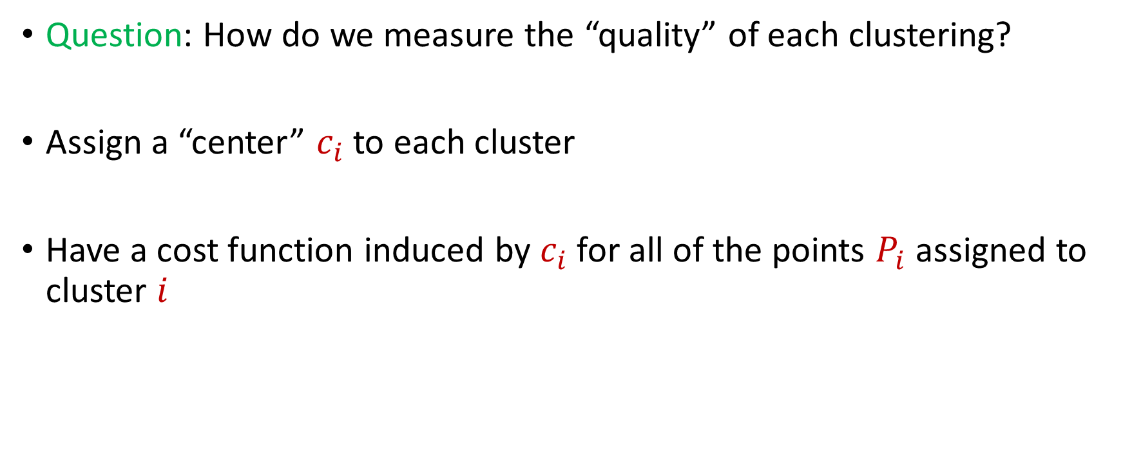
$k$-Clustering
Question: How do we measure the “quality” of each clustering?
Assign a “center” $c_{i}$ to each cluster
Have a cost function induced by $c_{i}$ for all of the points $P_{i}$ assigned to cluster $i$

Slide 6
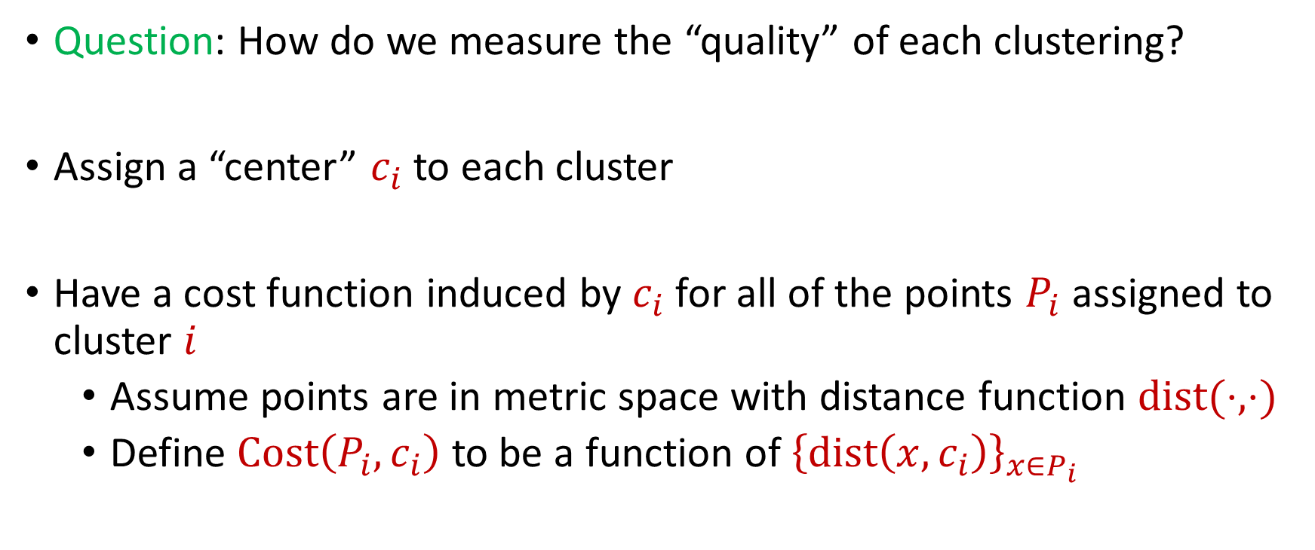
$k$-Clustering
Question: How do we measure the “quality” of each clustering?
Assign a “center” $c_{i}$ to each cluster
Have a cost function induced by $c_{i}$ for all of the points $P_{i}$ assigned to cluster $i$
Assume points are in metric space with distance function $dist(⋅,⋅)$
Define $Cost\left(P_{i},c_{i}\right)$ to be a function of ${\left\{dist\left(x,c_{i}\right)\right\}}_{x∈P_{i}}$

Slide 7
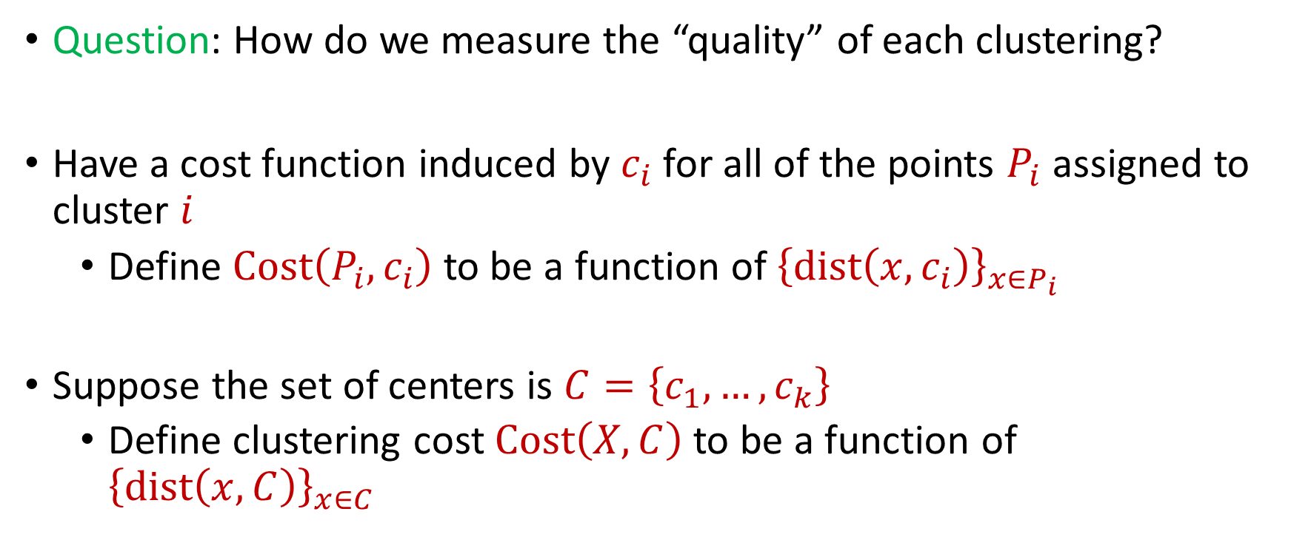
$k$-Clustering
Question: How do we measure the “quality” of each clustering?
Have a cost function induced by $c_{i}$ for all of the points $P_{i}$ assigned to cluster $i$
Define $Cost\left(P_{i},c_{i}\right)$ to be a function of ${\left\{dist\left(x,c_{i}\right)\right\}}_{x∈P_{i}}$
Suppose the set of centers is $C=\left\{c_{1},…, c_{k}\right\}$
Define clustering cost $Cost\left(X,C\right)$ to be a function of ${\left\{dist\left(x,C\right)\right\}}_{x∈C}$

Slide 8

$k$-Clustering
Define clustering cost $Cost\left(X,C\right)$ to be a function of ${\left\{dist\left(x,C\right)\right\}}_{x∈C}$

Slide 9
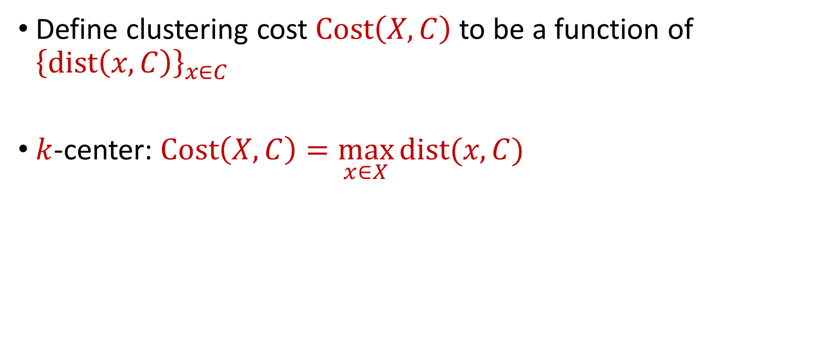
$k$-Clustering
Define clustering cost $Cost\left(X,C\right)$ to be a function of ${\left\{dist\left(x,C\right)\right\}}_{x∈C}$
$k$-center: $Cost\left(X,C\right)=\max_{x∈X}{dist(x,C)}$

Slide 10
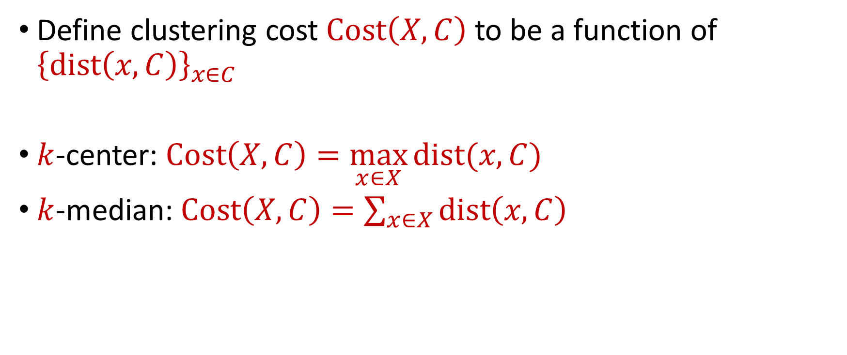
$k$-Clustering
Define clustering cost $Cost\left(X,C\right)$ to be a function of ${\left\{dist\left(x,C\right)\right\}}_{x∈C}$
$k$-center: $Cost\left(X,C\right)=\max_{x∈X}{dist(x,C)}$
$k$-median: $Cost\left(X,C\right)=\sum_{x∈X}{dist\left(x,C\right)}$

Slide 11

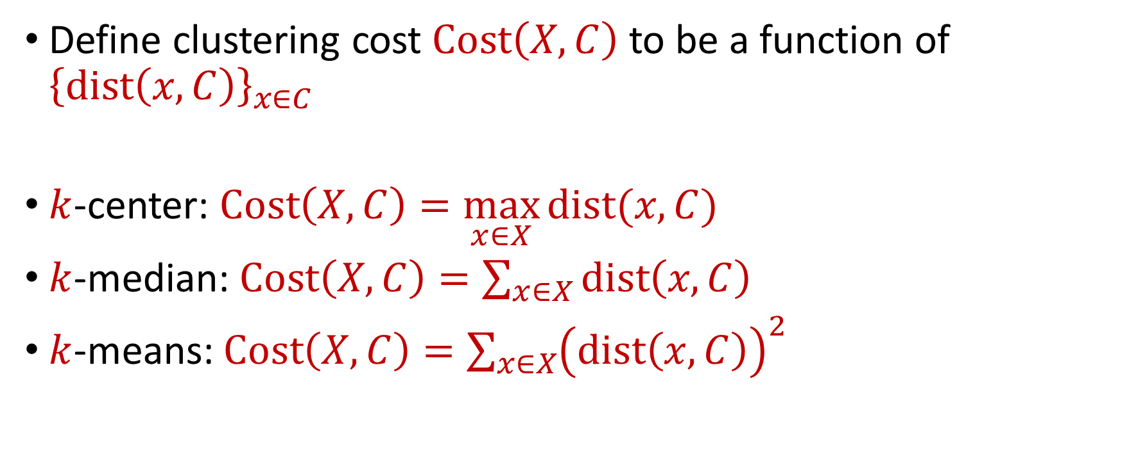






$k$-Clustering
Define clustering cost $Cost\left(X,C\right)$ to be a function of ${\left\{dist\left(x,C\right)\right\}}_{x∈C}$
$k$-center: $Cost\left(X,C\right)=\max_{x∈X}{dist(x,C)}$
$k$-median: $Cost\left(X,C\right)=\sum_{x∈X}{dist\left(x,C\right)}$
$k$-means: $Cost\left(X,C\right)=\sum_{x∈X}{{\left(dist\left(x,C\right)\right)}^{2}}$
$${\left(⋅\right)}^{2}$$
$${\left(⋅\right)}^{2}$$
$${\left(⋅\right)}^{2}$$
$${\left(⋅\right)}^{2}$$
$${\left(⋅\right)}^{2}$$
$${\left(⋅\right)}^{2}$$
$${\left(⋅\right)}^{2}$$

Slide 12

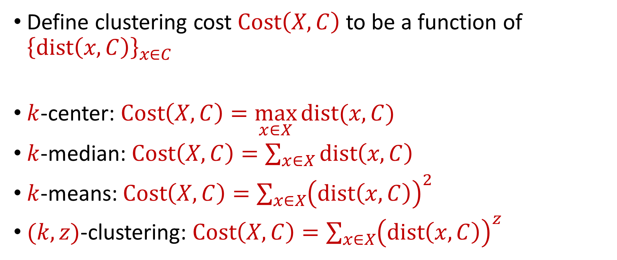






$k$-Clustering
Define clustering cost $Cost\left(X,C\right)$ to be a function of ${\left\{dist\left(x,C\right)\right\}}_{x∈C}$
$k$-center: $Cost\left(X,C\right)=\max_{x∈X}{dist(x,C)}$
$k$-median: $Cost\left(X,C\right)=\sum_{x∈X}{dist\left(x,C\right)}$
$k$-means: $Cost\left(X,C\right)=\sum_{x∈X}{{\left(dist\left(x,C\right)\right)}^{2}}$
$(k,z)$-clustering: $Cost\left(X,C\right)=\sum_{x∈X}{{\left(dist\left(x,C\right)\right)}^{z}}$
$${\left(⋅\right)}^{z}$$
$${\left(⋅\right)}^{z}$$
$${\left(⋅\right)}^{z}$$
$${\left(⋅\right)}^{z}$$
$${\left(⋅\right)}^{z}$$
$${\left(⋅\right)}^{z}$$
$${\left(⋅\right)}^{z}$$

Slide 13
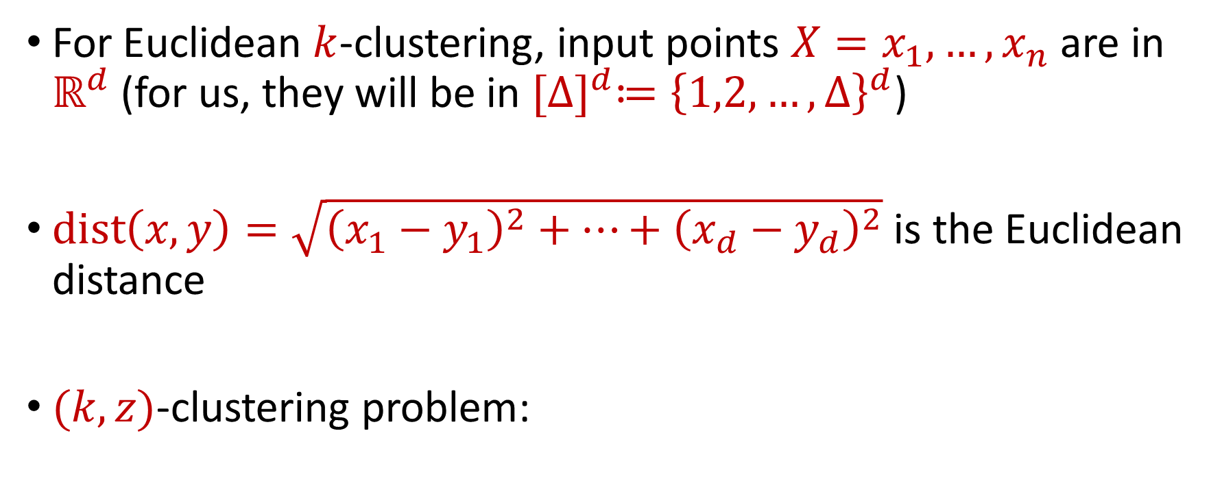

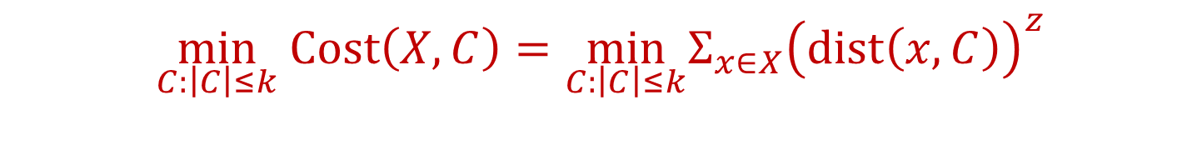
Euclidean $k$-Clustering
For Euclidean $k$-clustering, input points $X=x_{1},…,x_{n}$ are in $ℝ^{d}$ (for us, they will be in ${[Δ]}^{d}≔{\left\{1,2,…,Δ\right\}}^{d}$)
$dist\left(x,y\right)=\sqrt{{\left(x_{1}−y_{1}\right)}^{2}+…+{\left(x_{d}−y_{d}\right)}^{2}}$ is the Euclidean distance
$(k,z)$-clustering problem:
$$\min_{C:\left|C\right|≤k} Cost\left(X,C\right)=\min_{C:\left|C\right|≤k}{Σ_{x∈X}\left(dist\left(x,C\right)\right)}^{z}$$

Slide 14

The Streaming Model
Input: Updates to an underlying data set $X$ that arrive sequentially
Output: Evaluation (or approximation) of a given function
Goal: Use space sublinear in the size $n$of the input $X$

Slide 15
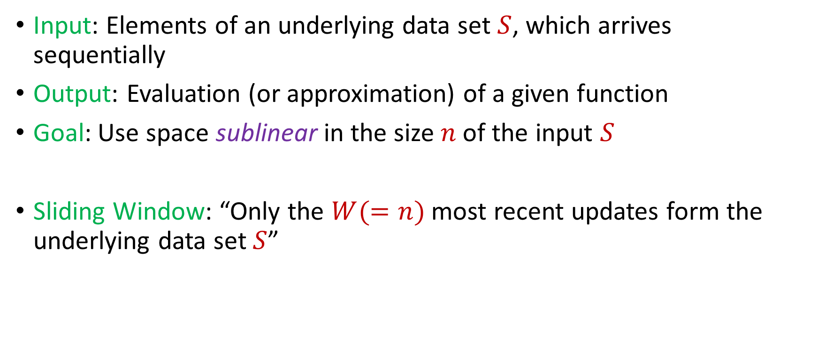
Streaming / Sliding Window Model
Input: Elements of an underlying data set $S$, which arrives sequentially
Output: Evaluation (or approximation) of a given function
Goal: Use space sublinear in the size $n$of the input $S$
Sliding Window: “Only the $W(=n)$ most recent updates form the underlying data set $S$”
1 0 1 1 1 0 0 1
Notes:
Let’s start by breaking down each of the terms in the title. To understand the sliding window model, we first have to understand the streaming model of computation, in which elements of an underlying data set S, arrive sequentially and the goal is to evaluate or approximate some given function on this dataset, using space sublinear in S. In the sliding window model, only the W most recent updates form the underlying data set

Slide 16
Streaming / Sliding Window Model
Input: Elements of an underlying data set $S$, which arrives sequentially
Output: Evaluation (or approximation) of a given function
Goal: Use space sublinear in the size $n$of the input $S$
Sliding Window: “Only the $W(=n)$ most recent updates form the underlying data set $S$”
1 0 1 1 1 0 0 1 1

Slide 17
Streaming / Sliding Window Model
Input: Elements of an underlying data set $S$, which arrives sequentially
Output: Evaluation (or approximation) of a given function
Goal: Use space sublinear in the size $n$of the input $S$
Sliding Window: “Only the $W(=n)$ most recent updates form the underlying data set $S$”
1 0 1 1 1 0 0 1 1 0

Slide 18
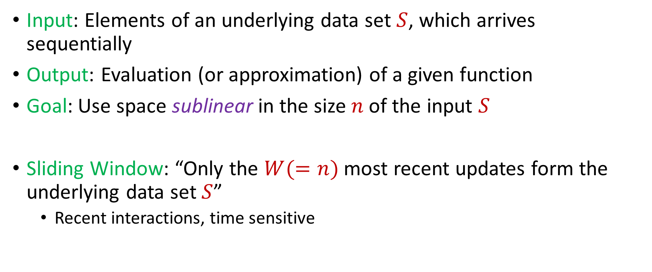
Streaming / Sliding Window Model
Input: Elements of an underlying data set $S$, which arrives sequentially
Output: Evaluation (or approximation) of a given function
Goal: Use space sublinear in the size $n$of the input $S$
Sliding Window: “Only the $W(=n)$ most recent updates form the underlying data set $S$”
Recent interactions, time sensitive
1 0 1 1 1 0 0 1 1 0 1
Notes:
The sliding window model emphasizes recent data and thus is appropriate for settings that are time sensitive.

Slide 19




Sliding Window Model
Consumer analytics: Consumer patterns may be sensitive to temporal trends or seasonal shifts
Notes:
The sliding window model emphasizes recent data and thus is appropriate for settings that are time sensitive.

Slide 20



Sliding Window Model
Data retention policy: the Facebook data policy says user search histories are stored for 6 months, the Apple differential privacy overview says collected user information is retained for 3 months, and the Google data retention policy states that browser information may be stored for up 9 months
Notes:
The sliding window model emphasizes recent data and thus is appropriate for settings that are time sensitive.

Slide 21
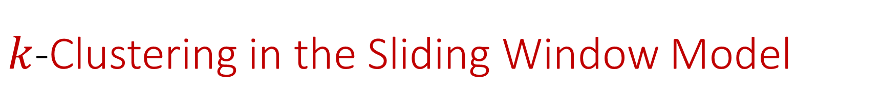
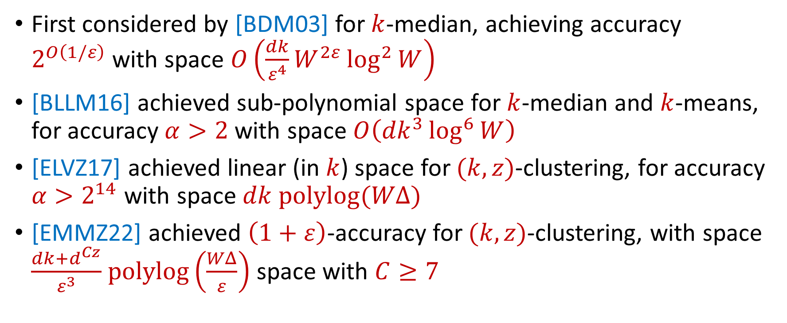
$k$-Clustering in the Sliding Window Model
First considered by [BDM03] for $k$-median, achieving accuracy $2^{O\left(1/ε\right)}$with space $O\left(\frac{dk}{ε^{4}}W^{2ε}\log^{2}{W}\right)$
[BLLM16] achieved sub-polynomial space for $k$-median and $k$-means, for accuracy $α>2$ with space $O\left({dk}^{3}\log^{6}{W}\right)$
[ELVZ17] achieved linear (in $k$) space for $(k,z)$-clustering, for accuracy $α>2^{14}$ with space $dk polylog(WΔ)$
[EMMZ22] achieved $\left(1+ε\right)$-accuracy for $(k,z)$-clustering, with space $\frac{dk+d^{Cz}}{ε^{3}}$ $polylog\left(\frac{WΔ}{ε}\right)$ space with $C≥7$
Notes:
The sliding window model emphasizes recent data and thus is appropriate for settings that are time sensitive.

Slide 22
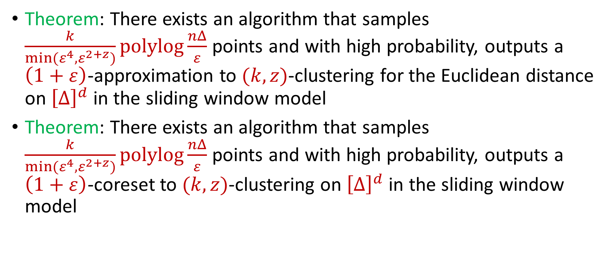
Our Results
Theorem: There exists an algorithm that samples $\frac{k}{min(ε^{4},ε^{2+z})}polylog\frac{nΔ}{ε}$ points and with high probability, outputs a $\left(1+ε\right)$-approximation to $(k,z)$-clustering for the Euclidean distance on ${\left[Δ\right]}^{d}$ in the sliding window model
Theorem: There exists an algorithm that samples $\frac{k}{min(ε^{4},ε^{2+z})}polylog\frac{nΔ}{ε}$ points and with high probability, outputs a $\left(1+ε\right)$-coreset to $(k,z)$-clustering on ${\left[Δ\right]}^{d}$ in the sliding window model
Notes:
The sliding window model emphasizes recent data and thus is appropriate for settings that are time sensitive.

Slide 23
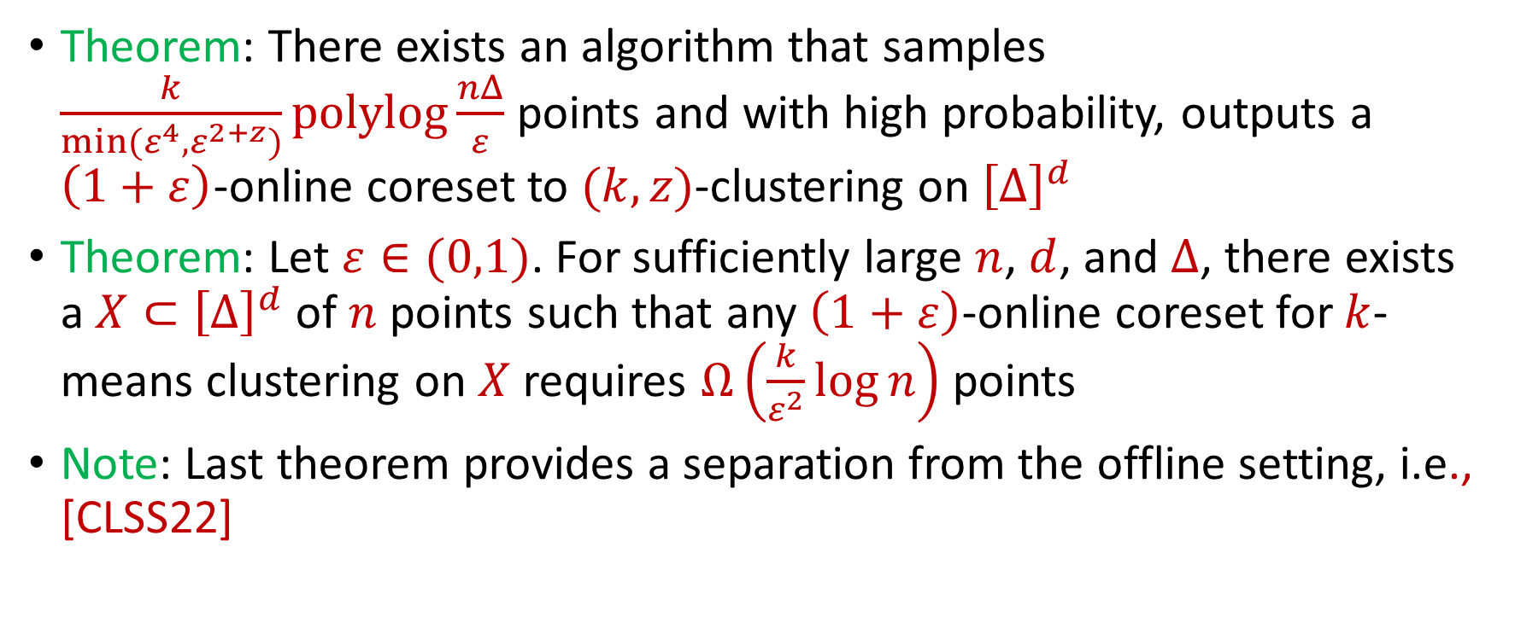
Our Results
Theorem: There exists an algorithm that samples $\frac{k}{min(ε^{4},ε^{2+z})}polylog\frac{nΔ}{ε}$ points and with high probability, outputs a $\left(1+ε\right)$-online coreset to $(k,z)$-clustering on ${\left[Δ\right]}^{d}$
Theorem: Let $ε∈(0,1)$. For sufficiently large $n$, $d$, and $Δ$, there exists a $X⊂{\left[Δ\right]}^{d}$ of $n$ points such that any $\left(1+ε\right)$-online coreset for $k$-means clustering on $X$ requires $Ω\left(\frac{k}{ε^{2}}\log{n}\right)$ points
Note: Last theorem provides a separation from the offline setting, i.e., [CLSS22]
Notes:
The sliding window model emphasizes recent data and thus is appropriate for settings that are time sensitive.

Slide 24
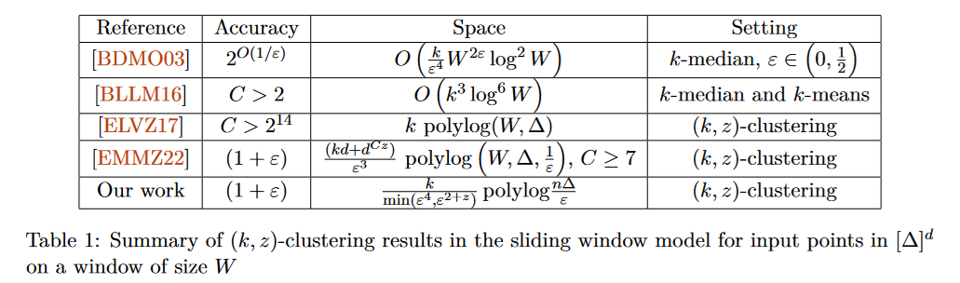
$k$-Clustering in the Sliding Window Model
Notes:
The sliding window model emphasizes recent data and thus is appropriate for settings that are time sensitive.

Slide 25
Sliding Window Model and Linear Sketches
Can we use linear sketches for the sliding window model?
Notes:
The sliding window model emphasizes recent data and thus is appropriate for settings that are time sensitive.

Slide 26
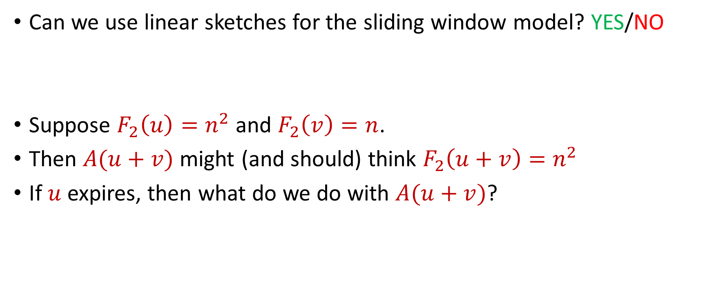


Sliding Window Model and Linear Sketches
Can we use linear sketches for the sliding window model? YES/NO
Suppose $F_{2}\left(u\right)=n^{2}$ and $F_{2}\left(v\right)=n$.
Then $A(u+v)$ might (and should) think $F_{2}\left(u+v\right)=n^{2}$
If $u$ expires, then what do we do with $A(u+v)$?
1 1 1 1 1 1 1 1 1 1 1 2 3 4 5 6 7 8 9 10 11
$$u$$
$$v$$
Notes:
The sliding window model emphasizes recent data and thus is appropriate for settings that are time sensitive.

Slide 27
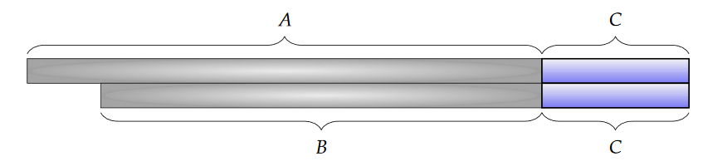
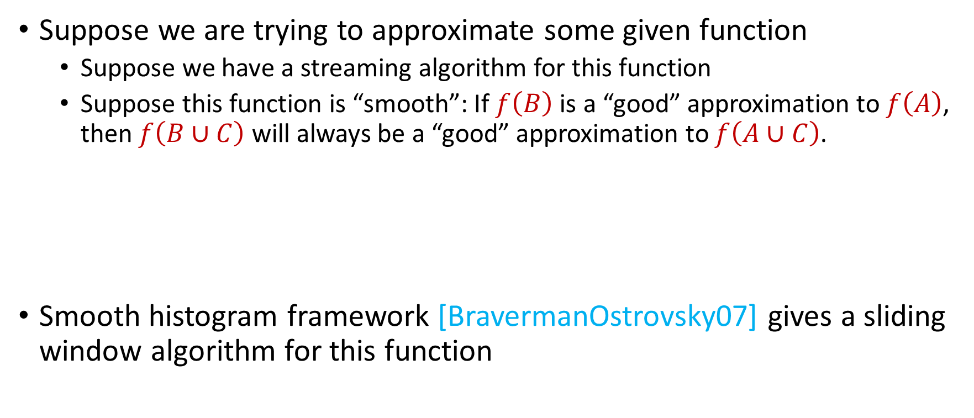
Sliding Window Algorithms
Suppose we are trying to approximate some given function
Suppose we have a streaming algorithm for this function
Suppose this function is “smooth”: If $f\left(B\right)$ is a “good” approximation to $f\left(A\right)$, then $f\left(B∪C\right)$ will always be a “good” approximation to $f\left(A∪C\right)$.
Smooth histogram framework [BravermanOstrovsky07] gives a sliding window algorithm for this function

Slide 28
Smooth Histogram
Suppose we are trying to approximate some given function
Smooth histogram framework [BO07] gives a sliding window algorithm for this function
Start a new instance of the streaming algorithm (along with existing instances) each time a new element arrives
Each time there are three instances that report “close” values, delete the middle one
Use different checkpoints to “sandwich” the sliding window

Slide 29
Smooth Histogram
Start a new instance of the streaming algorithm (along with existing instances) each time a new element arrives
Each time there are three instances that report “close” values, delete the middle one
Use different checkpoints to “sandwich” the sliding window
1
Example: Number of ones in sliding window (2-approximation)
1

Slide 30
Smooth Histogram
Start a new instance of the streaming algorithm (along with existing instances) each time a new element arrives
Each time there are three instances that report “close” values, delete the middle one
Use different checkpoints to “sandwich” the sliding window
1 0
Example: Number of ones in sliding window (2-approximation)
1
0

Slide 31
Smooth Histogram
Start a new instance of the streaming algorithm (along with existing instances) each time a new element arrives
Each time there are three instances that report “close” values, delete the middle one
Use different checkpoints to “sandwich” the sliding window
1 0 1
Example: Number of ones in sliding window (2-approximation)
2
1
1

Slide 32
Smooth Histogram
Start a new instance of the streaming algorithm (along with existing instances) each time a new element arrives
Each time there are three instances that report “close” values, delete the middle one
Use different checkpoints to “sandwich” the sliding window
1 0 1
Example: Number of ones in sliding window (2-approximation)
2
1

Slide 33
Smooth Histogram
Start a new instance of the streaming algorithm (along with existing instances) each time a new element arrives
Each time there are three instances that report “close” values, delete the middle one
Use different checkpoints to “sandwich” the sliding window
1 0 1
Example: Number of ones in sliding window (2-approximation)
2
1

Slide 34
Smooth Histogram
Start a new instance of the streaming algorithm (along with existing instances) each time a new element arrives
Each time there are three instances that report “close” values, delete the middle one
Use different checkpoints to “sandwich” the sliding window
1 0 1 1
Example: Number of ones in sliding window (2-approximation)
3
2
1

Slide 35
Smooth Histogram
Start a new instance of the streaming algorithm (along with existing instances) each time a new element arrives
Each time there are three instances that report “close” values, delete the middle one
Use different checkpoints to “sandwich” the sliding window
1 0 1 1 1
Example: Number of ones in sliding window (2-approximation)
4
3
2
1

Slide 36
Smooth Histogram
Start a new instance of the streaming algorithm (along with existing instances) each time a new element arrives
Each time there are three instances that report “close” values, delete the middle one
Use different checkpoints to “sandwich” the sliding window
1 0 1 1 1
Example: Number of ones in sliding window (2-approximation)
4
2
1

Slide 37
Smooth Histogram
Start a new instance of the streaming algorithm (along with existing instances) each time a new element arrives
Each time there are three instances that report “close” values, delete the middle one
Use different checkpoints to “sandwich” the sliding window
1 0 1 1 1 0 0 1 1 0 1
Example: Number of ones in sliding window (2-approximation)
7
4
2
1

Slide 38
Smooth Histogram
Start a new instance of the streaming algorithm (along with existing instances) each time a new element arrives
Each time there are three instances that report “close” values, delete the middle one
Use different checkpoints to “sandwich” the sliding window
1 0 1 1 1 0 0 1 1 0 1
Example: Number of ones in sliding window (2-approximation)
Number of ones in sliding window is at least 4 and at most 7
4 is a good approximation
7
4
2
1

Slide 39
Smooth Histogram
Converts a streaming algorithm for a smooth function into a sliding window algorithm
…Unfortunately, clustering is not smooth…

Slide 40
Sliding Window Model and Sampling

Slide 41
Sliding Window Model and Sampling

Slide 42

Coreset Construction and Sampling
Consider a fixed set $X$ and a fixed set $C$ of $k$ centers, which induces a fixed cost $Cost(X,C)$

Slide 43

Coreset Construction and Sampling
Consider a fixed set $X$ and a fixed set $C$ of $k$ centers, which induces a fixed cost $Cost(X,C)$
A simple way to obtain $X′$with $Cost\left(X^{′},C\right)≈Cost(X,C)$ is to uniformly sample points of $X$ into $X′$

Slide 44

Coreset Construction and Sampling
Consider a fixed set $X$ and a fixed set $C$ of $k$ centers, which induces a fixed cost $Cost(X,C)$
Uniform sampling needs a lot of samples if there is a single point that greatly contributes to $Cost(X,C)$

Slide 45

Coreset Construction and Sampling
Fix: Importance sampling, sample each point $x∈X$ into $X′$ with probability proportional $Cost(x,C)$, i.e., $Cost(x,C)/Cost(X,C)$

Slide 46
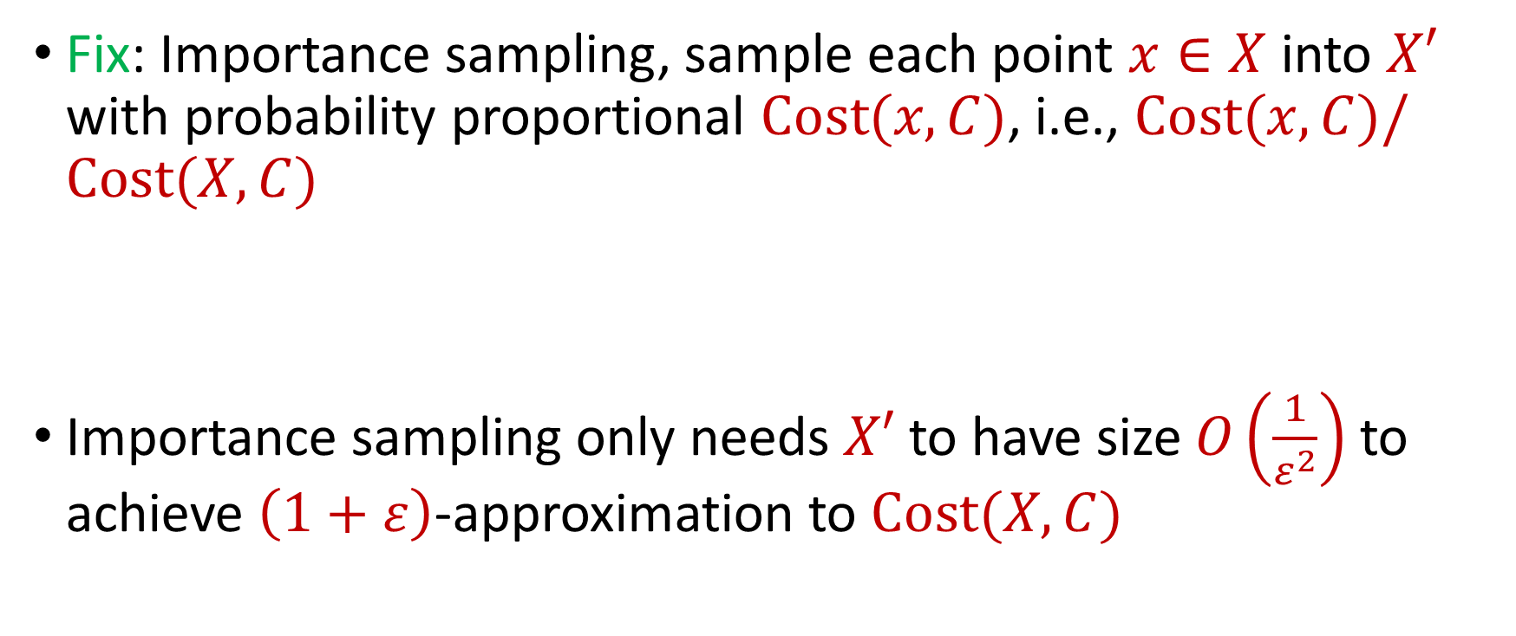
Coreset Construction and Sampling
Fix: Importance sampling, sample each point $x∈X$ into $X′$ with probability proportional $Cost(x,C)$, i.e., $Cost(x,C)/Cost(X,C)$
Importance sampling only needs $X′$ to have size $O\left(\frac{1}{ε^{2}}\right)$ to achieve $\left(1+ε\right)$-approximation to $Cost(X,C)$

Slide 47

Coreset Construction and Sampling
Importance sampling only needs $X′$ to have size $O\left(\frac{1}{ε^{2}}\right)$ to achieve $\left(1+ε\right)$-approximation to $Cost(X,C)$
What about a different choice $C$ of $k$ centers?

Slide 48
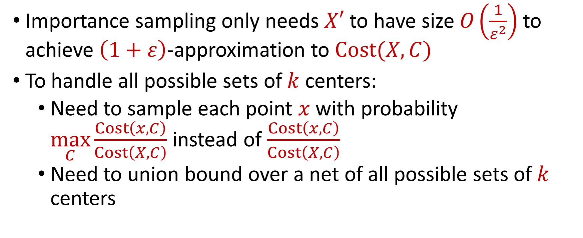
Coreset Construction and Sampling
Importance sampling only needs $X′$ to have size $O\left(\frac{1}{ε^{2}}\right)$ to achieve $\left(1+ε\right)$-approximation to $Cost(X,C)$
To handle all possible sets of $k$ centers:
Need to sample each point $x$ with probability $\max_{C}\frac{Cost\left(x,C\right)}{Cost\left(X,C\right)}$ instead of $\frac{Cost\left(x,C\right)}{Cost\left(X,C\right)}$
Need to union bound over a net of all possible sets of $k$ centers

Slide 49

Coreset Construction and Sampling
Importance sampling only needs $X′$ to have size $O\left(\frac{1}{ε^{2}}\right)$ to achieve $\left(1+ε\right)$-approximation to $Cost(X,C)$
To handle all possible sets of $k$ centers:
Need to sample each point $x$ with probability $\max_{C}\frac{Cost\left(x,C\right)}{Cost\left(X,C\right)}$ instead of $\frac{Cost\left(x,C\right)}{Cost\left(X,C\right)}$
Need to union bound over a net of all possible sets of $k$ centers
Net with size ${\left(\frac{nΔ}{ε}\right)}^{O(kd)}$

Slide 50
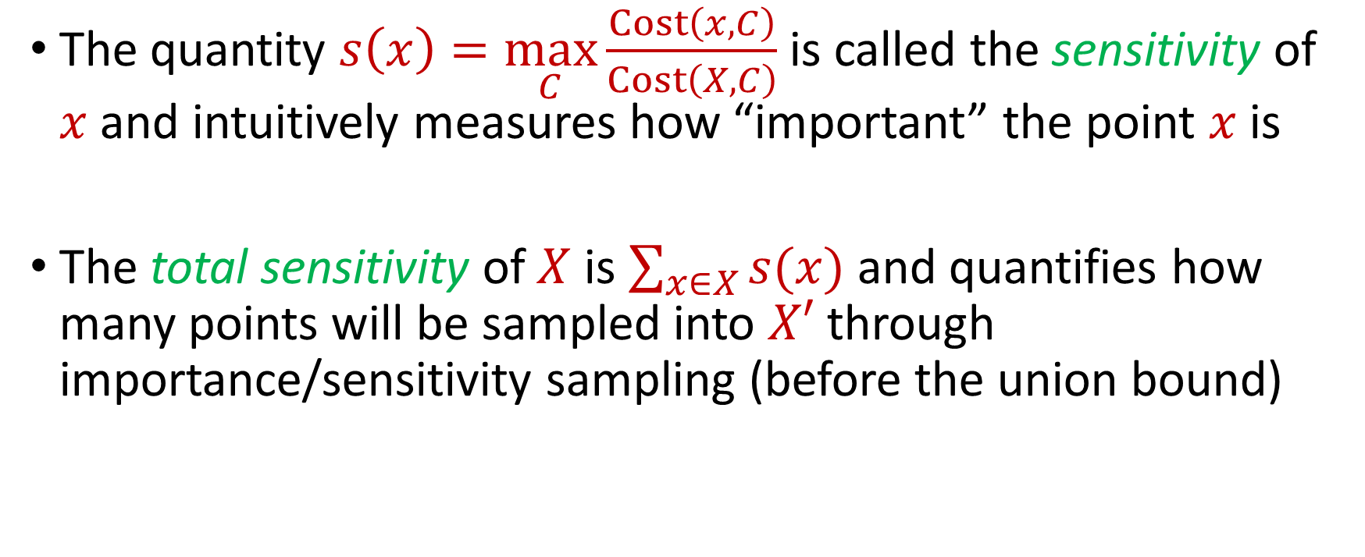
Sensitivity Sampling
The quantity $s\left(x\right)=\max_{C}\frac{Cost\left(x,C\right)}{Cost\left(X,C\right)}$ is called the sensitivity of $x$ and intuitively measures how “important” the point $x$ is
The total sensitivity of $X$ is $\sum_{x∈X}{s(x)}$ and quantifies how many points will be sampled into $X′$ through importance/sensitivity sampling (before the union bound)

Slide 51
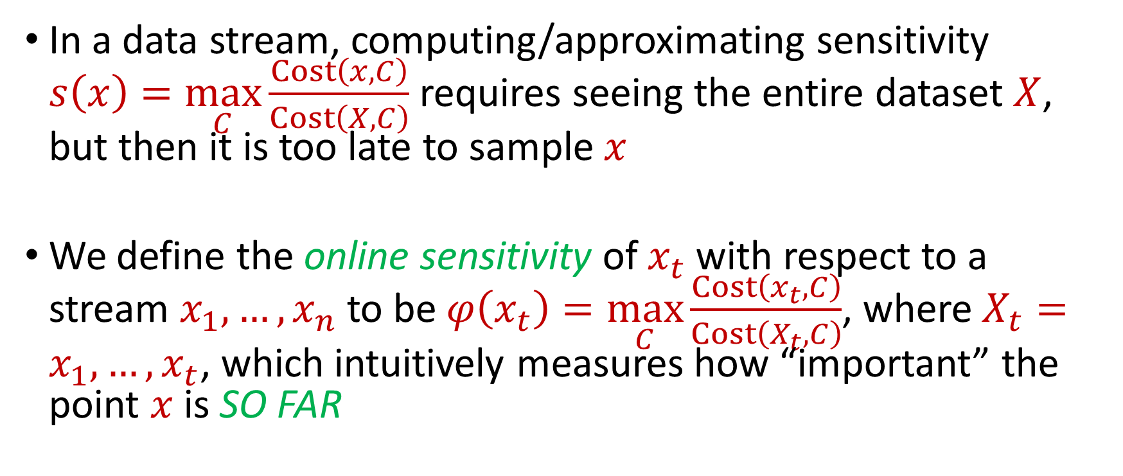
Online Sensitivity
In a data stream, computing/approximating sensitivity $s\left(x\right)=\max_{C}\frac{Cost\left(x,C\right)}{Cost\left(X,C\right)}$ requires seeing the entire dataset $X$, but then it is too late to sample $x$
We define the online sensitivity of $x_{t}$ with respect to a stream $x_{1},…,x_{n}$ to be $φ\left(x_{t}\right)=\max_{C}\frac{Cost\left(x_{t},C\right)}{Cost\left(X_{t},C\right)}$, where $X_{t}=x_{1},…,x_{t}$, which intuitively measures how “important” the point $x$ is SO FAR

Slide 52
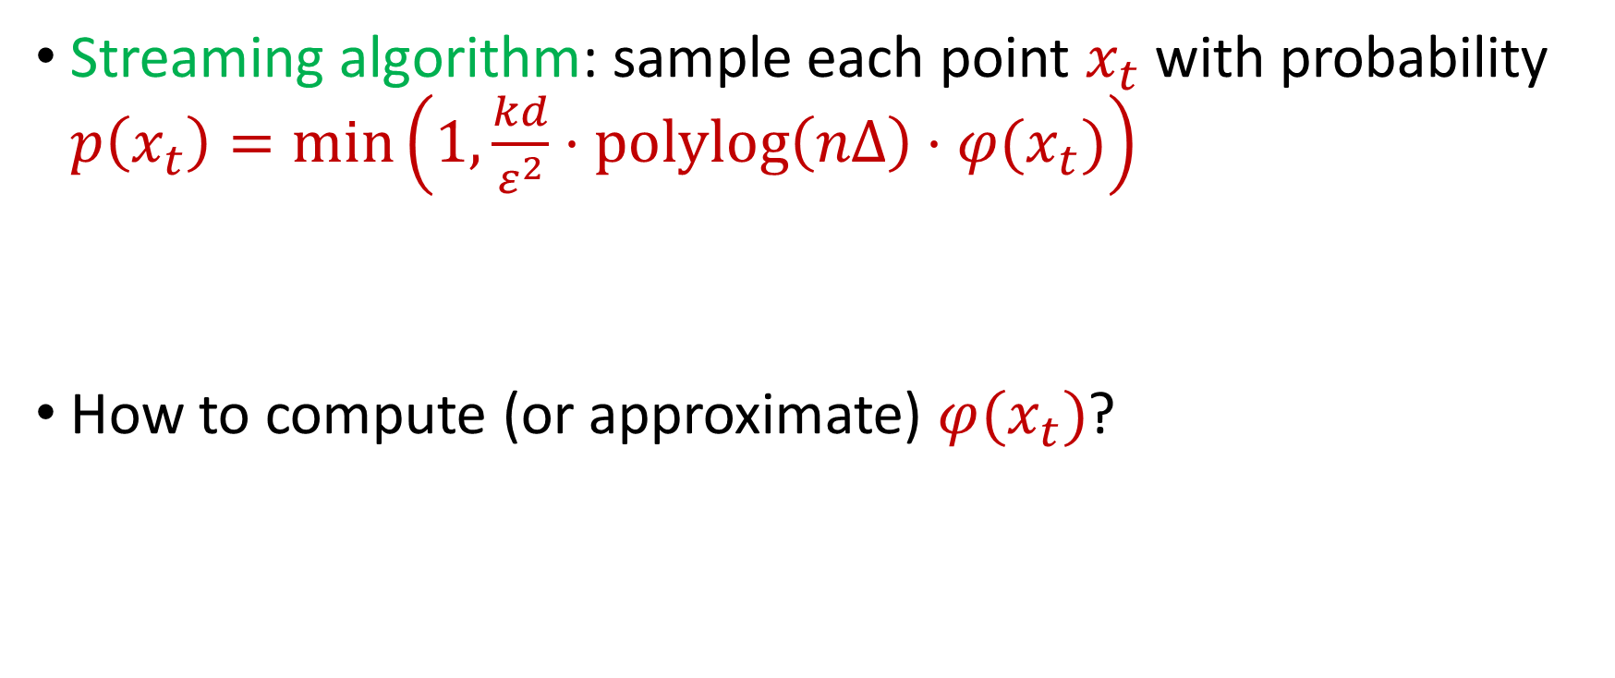
Online Sensitivity
Streaming algorithm: sample each point $x_{t}$ with probability $p\left(x_{t}\right)=\min\left(1,\frac{kd}{ε^{2}}⋅polylog\left(nΔ\right)⋅φ(x_{t})\right)$
How to compute (or approximate) $φ(x_{t})$?

Slide 53
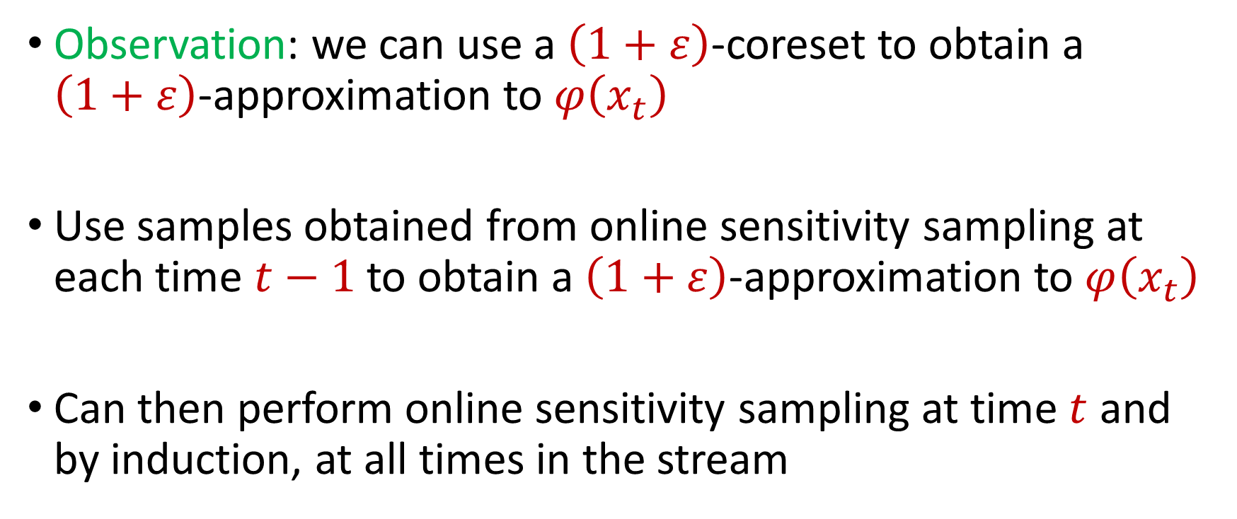
Online Sensitivity
Observation: we can use a $\left(1+ε\right)$-coreset to obtain a $\left(1+ε\right)$-approximation to $φ\left(x_{t}\right)$
Use samples obtained from online sensitivity sampling at each time $t−1$ to obtain a $\left(1+ε\right)$-approximation to $φ\left(x_{t}\right)$
Can then perform online sensitivity sampling at time $t$ and by induction, at all times in the stream

Slide 54
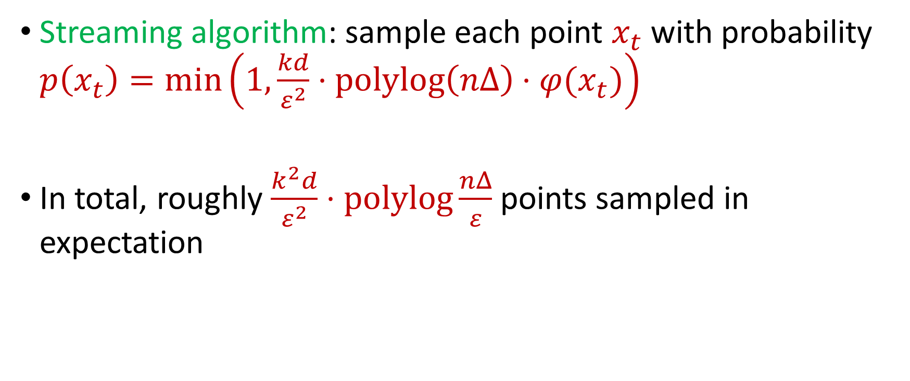
Online Sensitivity
Streaming algorithm: sample each point $x_{t}$ with probability $p\left(x_{t}\right)=\min\left(1,\frac{kd}{ε^{2}}⋅polylog\left(nΔ\right)⋅φ(x_{t})\right)$
In total, roughly $\frac{k^{2}d}{ε^{2}}⋅\operatorname{polylog}{\frac{nΔ}{ε}}$ points sampled in expectation

Slide 55
Sliding Window Model and Sampling
Previous intuition: we can sample each point with probability proportional to how “important” the point is
We can also consider the “importance” of each point with respect to the following points in the stream
New intuition: previous points do not matter in the importance of a point because the previous points can be expired

Slide 56

Sliding Window Model and Sampling
Theorem: There exists a sliding window model algorithm that samples roughly $\frac{k^{2}d}{ε^{2}}⋅\operatorname{polylog}{\frac{nΔ}{ε}}$ points and outputs a coreset for $(k,z)$-clustering [WoodruffZhongZhou23]

